Slide 1
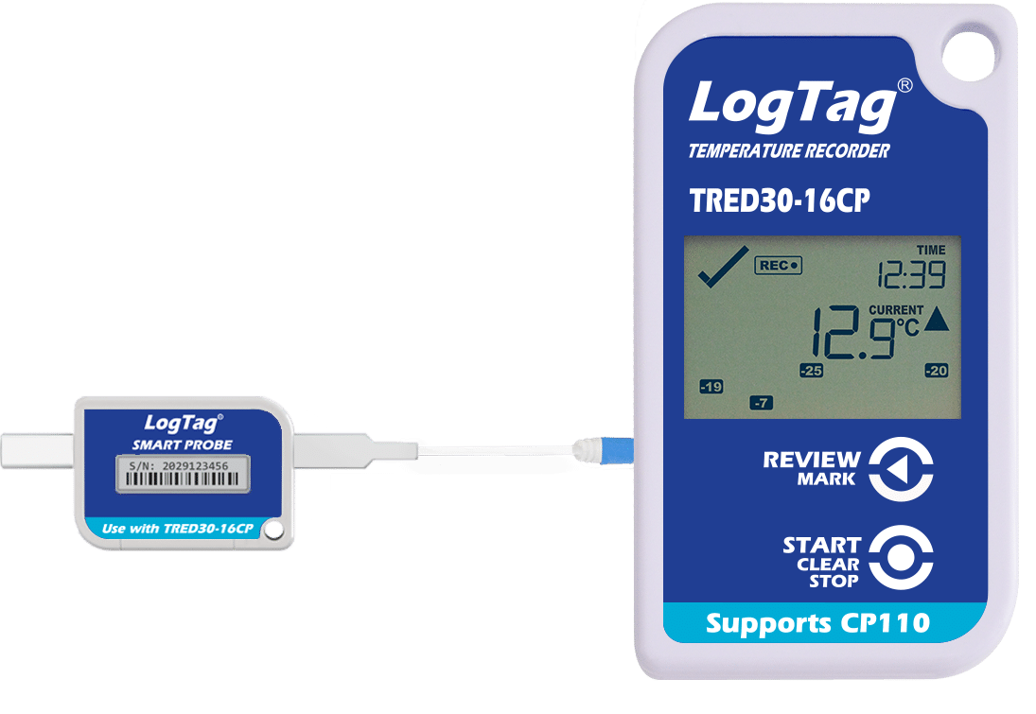
LogTag Quick Start Guide For TRED30-16CP Loggers with SMART PROBE
23-1120
Notes:
This template can be used as a starter file for presenting training materials in a group setting.
Sections
Right-click on a slide to add sections. Sections can help to organize your slides or facilitate collaboration between multiple authors.
Notes
Use the Notes section for delivery notes or to provide additional details for the audience. View these notes in Presentation View during your presentation.
Keep in mind the font size (important for accessibility, visibility, videotaping, and online production)
Coordinated colors
Pay particular attention to the graphs, charts, and text boxes.
Consider that attendees will print in black and white or grayscale. Run a test print to make sure your colors work when printed in pure black and white and grayscale.
Graphics, tables, and graphs
Keep it simple: If possible, use consistent, non-distracting styles and colors.
Label all graphs and tables.

Slide 2
Unpacking the Loggers
Each kit has been checked by our staff to ensure it is complete and includes the following items:
TRED30-16CP Data Logger
Smart Probe w/60ml Glycol Bottle
Fridge and Freezer Label Stickers
Wall Mount Bracket (LTI-MOUNT)
Spare CR2032 Coin Cell Battery
1 piece Velcro
2 Zip Ties
Calibration Certificate
If you are unable to find anything listed on the check-list, please contact us through our website or by phone at 603-746-5524

Slide 3
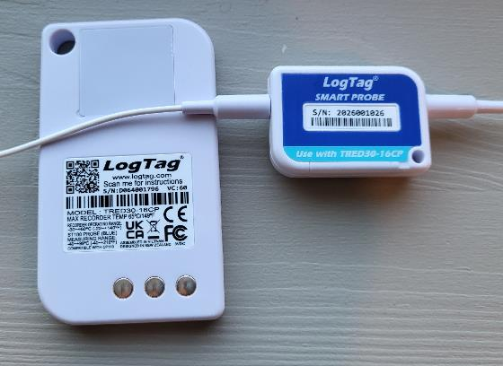
Important!! Probe and Logger Serial Numbers
Smart Sensors feature their own unique serial number which is recorded on the calibration certificate. Because of this, the serial number on the Smart Sensor will be different than that of the logger itself. We recommend using the included Fridge/Freezer stickers to label the sensor appropriately to ensure that you connect the correct logger to the correct Smart Sensor.

Slide 4
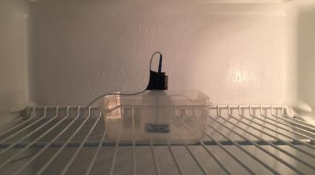
Install the Vial and Probe Cable
Place the Glycol Bottle in center of fridge/freezer unit
Secure the bottle with tape or the Velcro
Place the bottle in a tray if used with wire rack
Run the probe cable through hinge side of door
Use tape and/or the zip ties included to secure the cable to the inside and outside of the unit to keep it secure and out of the way.
Allow 2 hours for glycol solution to adjust to temperatures in the fridge/freezer before starting to record with the logger

Slide 5
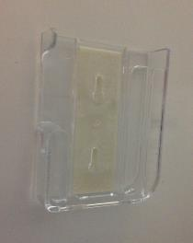
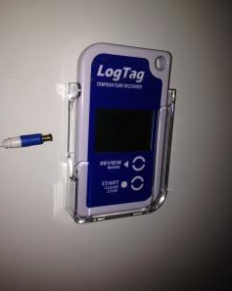
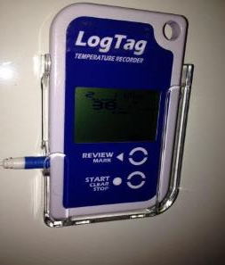
Installing the Logger
Identify mounting location outside of fridge/freezer
Be sure it’s within reach of the probe and is easily accessible
Make sure the surface is clean and dry, attach the wall mount bracket using the double-sided tape included in the package with the mount
When placing the logger into mount, the probe should not be attached. Once the logger is in place you can plug in the probe.

Slide 6
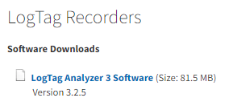
Install Software
You must be logged in with full administrator rights to properly install the software. This may mean that your IT department may need to install the software for you. You can find the LogTag Analyzer Software on the software downloads page of our website: www.MicroDAQ.com/software
Click on the link to download LogTag Analyzer 3
Follow the on-screen instructions to complete the installation process.
The user manual for the software can be found by clicking on the Help menu in the software and selecting “user guide”

Slide 7
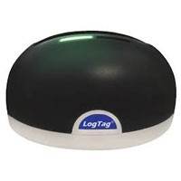
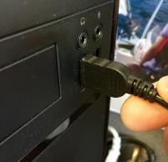
Install Docking Station
The LogTag loggers require a USB docking station to connect to your computer for configuration as well as saving data. This docking station is a universal device and compatible with many LogTag models. This device is sold separately and does not come with the kit.
Once software is installed plug the docking station (LTI-HID) into your PC by inserting the USB plug into an available USB port
Locate the LogTag Analyzer (LTA) icon on your desktop and double click it to launch the software

Slide 8
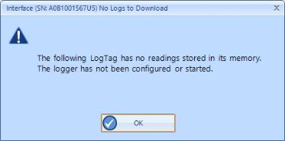
Configuring the Logger
The loggers will need to be configured for Fridge or Freezer use using the recommended settings for your state. Please contact your VFC/DOH representative or office for the specific configuration settings for your state. The settings shown in the following slides are for example only – the settings for your state may vary.
Open LogTag Analyzer Software (If not already open)
Place the Logger into docking station – Push down until you hear logger click into place. The software will recognize the device and tell you “A new log tag has been detected. Please wait while the information is downloaded”
If this is your first time inserting the logger, a notification box will pop up telling you that there is no data on the device. Click “OK” to proceed, this message will time out and disappear after 5 seconds by default.

Slide 9
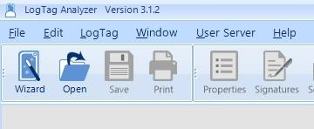
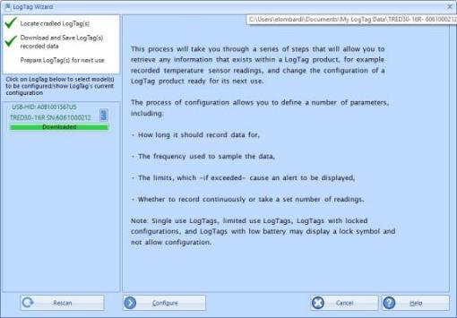
Configuring the Logger
Launch the Configuration Wizard by clicking on the Wizard icon. The software will then scan for available loggers
Once the logger is found you should see two green checkmarks in the top left corner. Click on the “Configure” button to continue to the configuration options

Slide 10
Configuring the Logger
Description: Give each logger a unique name for easy identification
We do not recommend selecting the password options, leave the check boxes blank
Make sure “Push button start” appears below Logging Parameters

Slide 11
Configuring the Logger
“Record readings so that” should be selected
The number of days the device will record for is based on the maximum storage capacity of the device and the recording rate. The faster you record, the faster it will fill up. Once it is full it will stop recording.
Set “Record a reading every” to your desired sample rate
Optional - Set “Begin recording after a delay of” to desired minutes
This feature creates a delay from the time you start the logger to the time it starts recording. This will allow you time to plug in the sensor cable before the logger starts recording data. Please check with your local VFC/DOH Office to see if this feature is approved for your state.

Slide 12
Configuring the Logger
Confirm the following settings*
Place a check in the box enabling the Audible alarm
Make sure Logger display temperature unit is set correctly for you
Check the box next to “Trigger alarm when readings above/equal”
46.5°F (8.1°C )* is in the field for Fridge or 5.0°F (-15.0°C)* for Freezer
Check the box next to “Trigger alarm when readings below/equal”
35.5°F (-1.9°C)* is in the field for Fridge or -40°F (-40°C)* for Freezer
*All values are for example purposes only – Please confirm settings with your local DOH Representative

Slide 13
Configuring the Logger
Click “Advanced Settings” tab and select the following options*
Box is checked for “Alarm remains on even if readings return to non-violation range”
Box is checked for “Allow logging to stop with STOP button”
All other boxes should remain blank
*Always confirm settings with VFC/DOH Office

Slide 14
Configuring the Logger
Click “Additional Features” tab and select the following options*
Box is checked for additional display text and “Show total summary days collected” is selected
Circle is selected for “Enable Smart Probe”
All other boxes should remain blank
Once settings are complete click the “Configure” button
*Always confirm settings with VFC/DOH Office

Slide 15
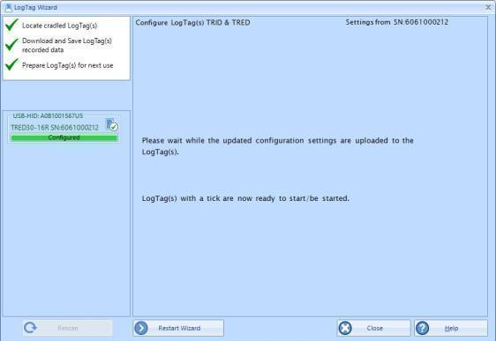
Configuring the Logger
When you have three green checkmarks, and the status bar shows “Configured” the logger can be removed from docking station
If you don’t have any other loggers to set up, click “Close” or if you have another logger to configure insert it in the docking station and click “Restart Wizard”

Slide 16
Attach Probe to Logger
You can now bring the logger back to its proper location, place it into the wall mount bracket, and carefully reattach the probe
Insert the plug end of the probe into the jack on logger. You should hear the plug “Click” into place
Care must be taken not to damage the probe tip. Inserting the probe into the logger at an angle will damage it
Important! – Make sure you are plugging the proper probe into the correct logger. Failure to do this will cause the logger to go into an alarm state.

Slide 17
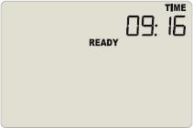
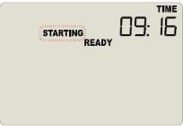
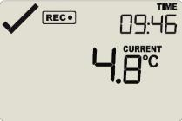
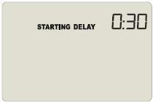
Starting the Logger
It is recommended that you read through the next few slides before attempting to start your logger. Once done please go through them again while you follow along with your logger.
Confirm that “Ready” is displayed on the LCD Screen
Press and hold the start button and observe that the “STARTING” starts flashing – Continue to hold button down, as soon as “STARTING” stops flashing and stays on the screen immediately release the button.
If correctly started the logger will then show the current temperature and display the REC symbol – If goes back to “Ready” try again.
If a Start Delay was applied, it will be shown on this screen with a timer. Once the timer expires the display will show current temperature, time and any alarm triggers.
*Time/Temp data shown below are examples only – your time/temp data may be different
1.
2.
3.
4.

Slide 18
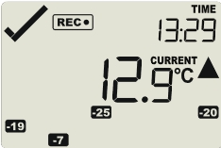
During Recording
During normal operation, the display shows the most recently recorded temperature. This temperature is updated at the same rate as the logging interval. The current time is also displayed (in 24-hour format). A tick symbol ✓ is shown as long as no alarm event has occurred. If an alarm event is registered, a cross symbol X is shown instead of the tick. At the bottom of the display, you can see an alarm day summary, any days on which an alarm was recorded are highlighted. Following are some sample display screens:
At 1:29 pm the display shows the following:
Alarm events were recorded 7, 19, 20, & 25 days ago.
The current temperature is over the upper alarm threshold, as indicated by the upper alarm marker ().
The duration, however, of this temperature excursion has not yet triggered an alarm.

Slide 19
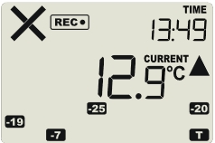
During Recording
When an alarm is triggered, an X will appear in the top left corner of the screen and the device will begin beeping.
Clearing Alarms: Alarms are cleared by stopping the logger, downloading the data, reviewing the excursion, and re-launching the logger using the Wizard tool (see next section View/Save Logger Data).

Slide 20
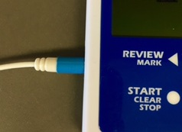
View/Save Logger Data
Stop the recording process by pressing and holding the “Start/clear/stop” button
When “STOPPED” is no longer flashing release the button
You should see “STOPPED” on screen
It is important to confirm that the logger is stopped before unplugging the probe
Unplug probe from Logger – grasp onto probe plug (blue band) and pull straight out from the Logger Important: Do not pull on the probe cable as this can permanently damage the probe.
Slide logger out of mount

Slide 21
View/Save Logger Data
Take the logger to your computer that has the software and docking station
Open LogTag Analyzer Software
Insert Logger into docking station – Be sure Logger “clicks” into place
Data is automatically saved to computer and opens a window that displays the “Chart” tab with the graph

Slide 22
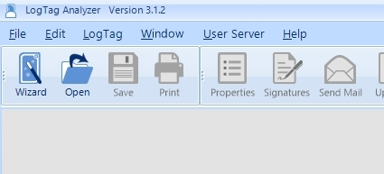
View/Save Logger Data
Additional views and report options can be chosen from the tabs at the bottom of the window
Once graph is visible the data has been saved and the logger can be re-launched.
To re-launch the logger, click on the Wizard button

Slide 23
View/Save Logger Data
The logger can now be re-launched by following the same procedure described in the “Configuring the Logger” section
The logger will retain the configuration settings that were previously assigned; however, we recommend double checking that they are correct before sending the configuration to the logger and re-launching the logger – see “Configuring the Logger” section
Once configuration is complete and saved to the logger you can remove the logger from the docking station and return it to its proper location

Slide 24
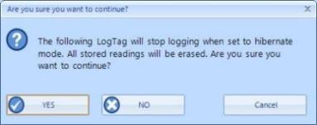
Changing The Battery
The battery life on your LogTag Logger is up to approximately 1-year. If you see the low battery indicator on the LCD screen, or get a pop-up warning when downloading the logger, you will need to replace the battery. Your logger kit included a spare CR2032 coin cell battery which is to be used when a replacement is needed.
Step 1: Open the software and Insert the logger into the docking station to save any recorded data, you should see the graph come up on the screen.
Step 2: With the logger still in the docking station click on “LogTag” menu and select “Hibernate” Once you click on “Hibernate” you will get a pop-up warning you that all the data on the logger will be deleted. Click “YES” to place the logger into Hibernation.
WARNING: Failure to hibernate the logger may result in serious memory corruption. This may cause unrepairable damage to the logger as a result.

Slide 25
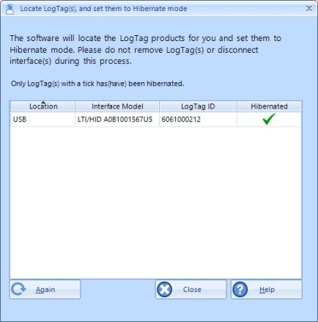
Changing The Battery
Step 3: Once you click “YES” and see a green check in the Hibernated column your logger will be in Hibernation mode – Once complete click “Close” and remove your logger from the docking station

Slide 26
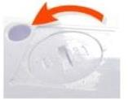
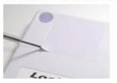
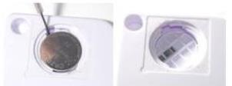
Changing The Battery
Step 4: Remove battery cover: On the back of the device at the top you will notice a square sticker. Carefully remove this sticker that is covering the battery compartment with a small, flat-head screwdriver (fig 1)
Use a coin to turn the battery cover in counter-clockwise direction to open the compartment (fig 2)
Remove the battery using a small, flat-head screwdriver (fig 3)
Fig 1
Fig 2
Fig 3

Slide 27
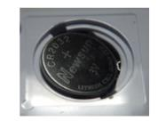
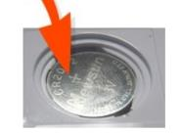
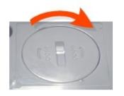
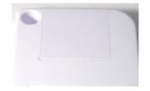
Changing The Battery
Step 5: Place the battery into the compartment as shown; the right-hand edge of the battery is inserted first against the contact (fig 4)
Press firmly down on the left-hand side of the battery, it should click into place (fig 5)
Replace the battery cover, turn clockwise to lock in place (fig 6)
Replace the sticker to cover the battery compartment and reconfigure the logger using the wizard tool to wake it up out of hibernation and restart it (fig 7)
Please recycle or dispose of the old battery according to your local environmental regulations.
Fig 4
Fig 5
Fig 6
Fig 7

Slide 28
Troubleshooting
Issue: Display says “Stopped” and won’t restart
Solution: Device memory may be full. Review section on View/Save Logger Data
Issue: Logger doesn’t start after pressing “Start” button
Solution: Review section on Starting the Logger
Issue: Display says “not rdy” when pressing the start button
Solution: Device has not been configured, review section on Configuring the logger
Issue: Display or data shows --.- as temperature reading
Solution: Probe is not plugged into logger or not properly attached when device was running, reattach probe to logger and wait for the next logging interval for the temperature to display. If probe is securely plugged into the logger, and you still have dashes, call MicroDAQ for further information (603)746-5524.
Issue: Software/PC doesn’t recognize that Logger is plugged into dock
Solution 1: Make sure you see a battery symbol in the top right corner of the LCD screen on the logger; device won’t be recognized if the battery is dead
Solution 2: Ensure the docking station is plugged into the computer, try a different USB port
Solution 3: Ensure contacts on back of logger are clean and not covered by a sticker
Solution 4: Ensure logger is firmly seated in docking station facing the right direction.

Slide 29
Additional Support
Detailed instructions on using the logger and Analyzer Software can be found in the LogTag Analyzer manual
Manual can be downloaded from the website or by clicking on the “help” option from inside the LTA software
Calibration service can be purchased or quoted from our site www.microdaq.com/calibration.php
Technical support is available from MicroDAQ, LLC Monday – Friday from 9:30 to 4:30 EST by calling 603-746-5524 or by using our support form found at www.microdaq.com/support

